Slide 1
FEG Digital Expense Report Guide
If you have any questions on the reimbursement process please email AP@fegllc.com
Also please see the FAQ section and the end of the slide show

Slide 2
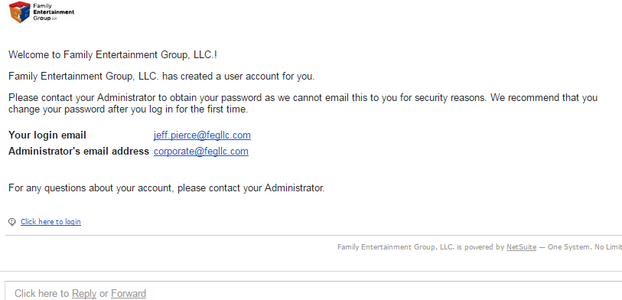
This is the email you will receive if you have access to submit expense reports manually
Not everyone will have access to the portal. Only people who frequently submit expense reports. If you need access contact ap@fegllc.com
Your password will be given in a separate email
Click “Click here to login” to get started on creating a login

Slide 3
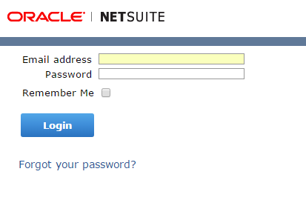
This is the login page for the expense report portal
Bookmark this page for quick and easy access or copy this url: https://system.na2.netsuite.com/pages/login.jsp
Type in your FEG email and the password that was emailed separately to you. If you never got a password contact ap@fegllc.com

Slide 4
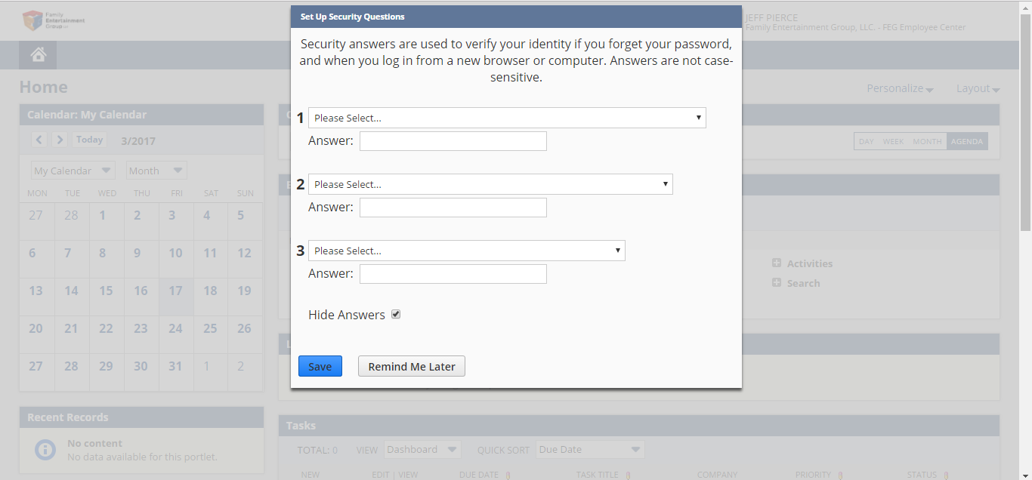
Upon login you will be prompted to change your password and set up security questions

Slide 5
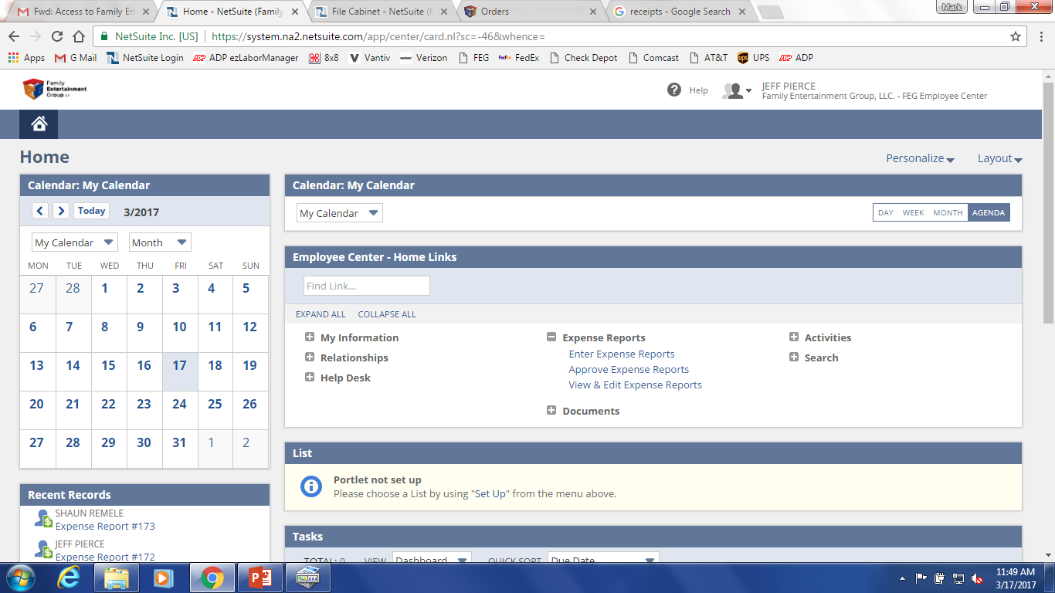
From the dashboard you can navigate to enter expense reports or approve them if you have the approval authority
To enter an expense report click “Enter Expense Reports”

Slide 6
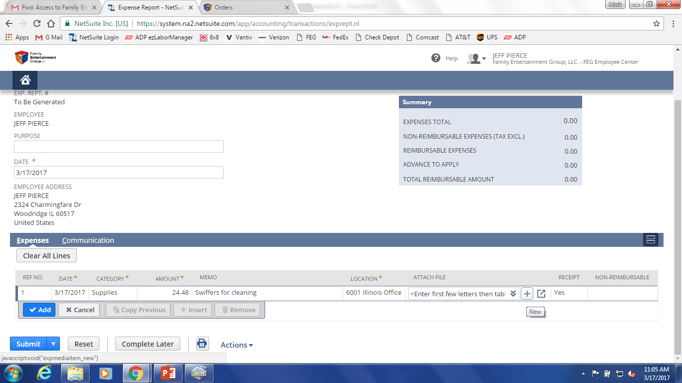
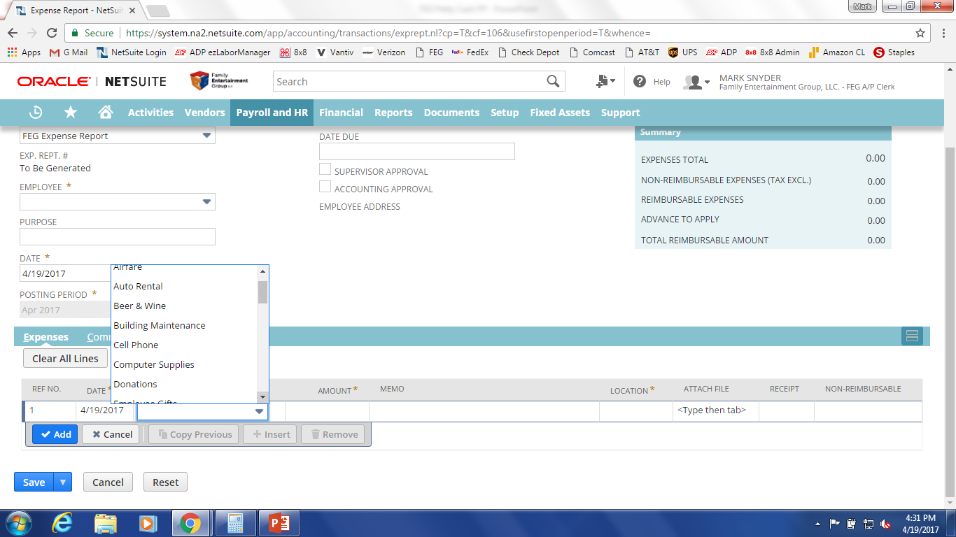
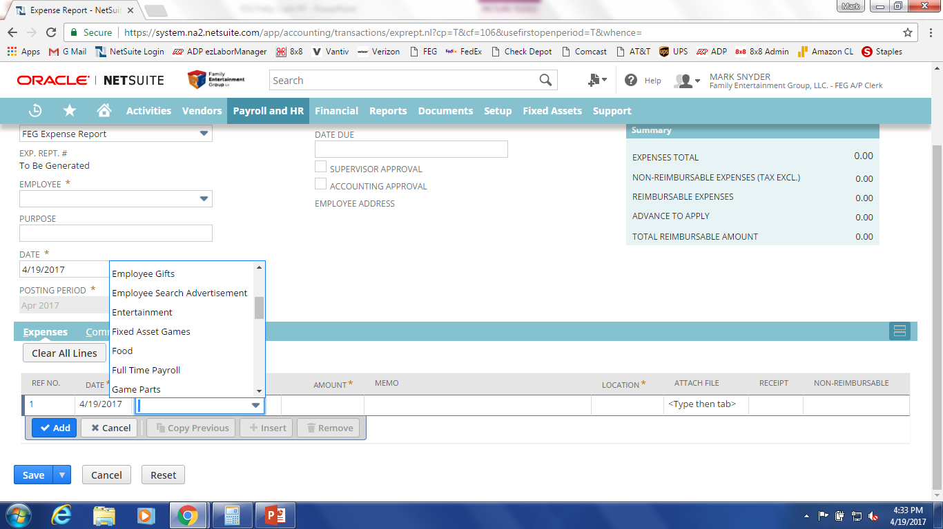


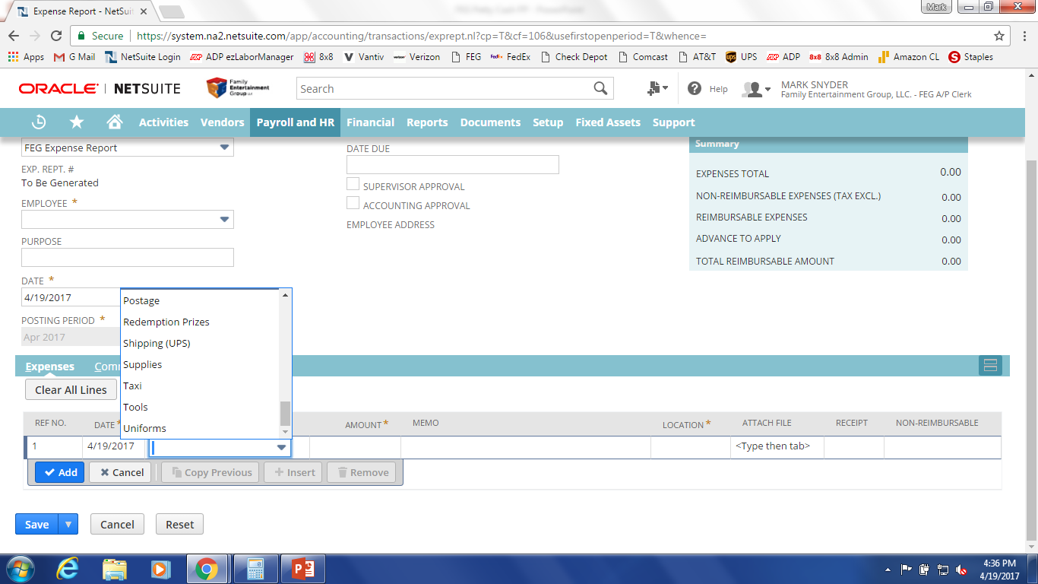
Jeff Pierce
123 Fake St.
Itasca, IL 60143
Step 2
Step 1
Step 1. Date: Select the date of the expense receipt
Step 2. Category: Pick the category of the type of expense
Below are some examples of categories to choose from
If your not sure what category to pick please email ap@fegllc.com

Slide 7
Jeff Pierce
123 Fake St.
Itasca, IL 60143
Step 3
Step 4
Step 3. Amount: Put in the amount of the receipt
Step 4. Memo: Briefly describe what the expense is and what it is for

Slide 8
Jeff Pierce
123 Fake St.
Itasca, IL 60143
Step 5
Step 6
Step 5: Choose the location benefiting from the expense
Step 6: To attach a receipt hit the plus button

Slide 9
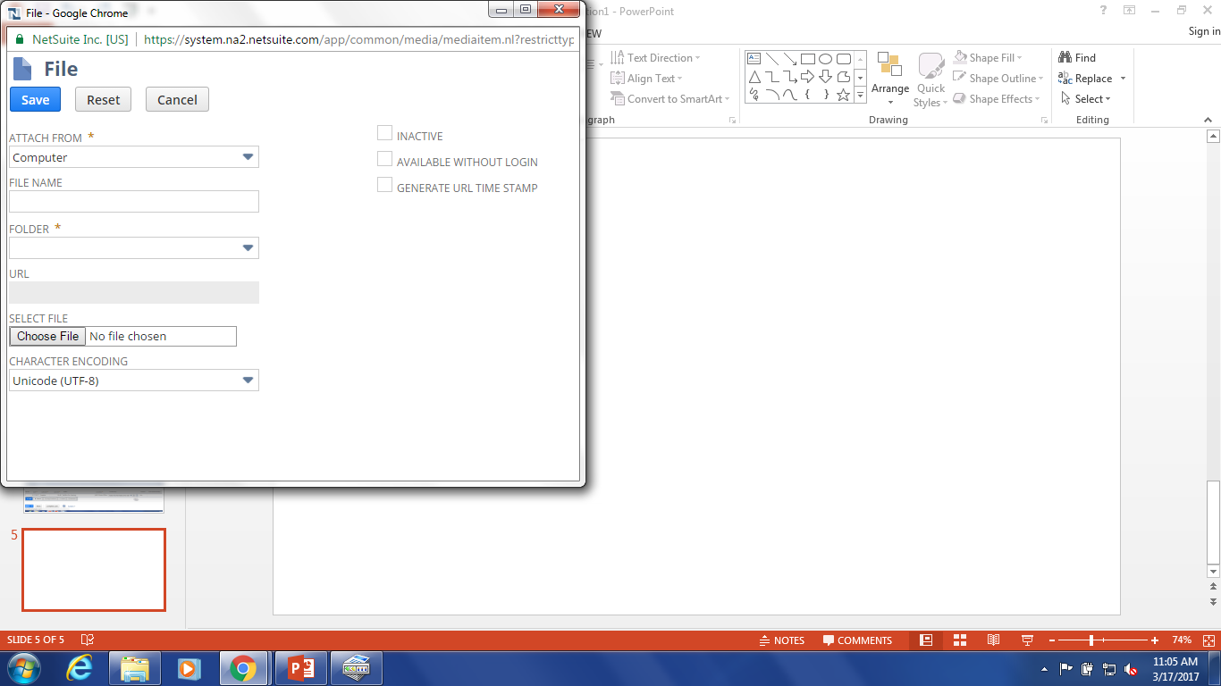
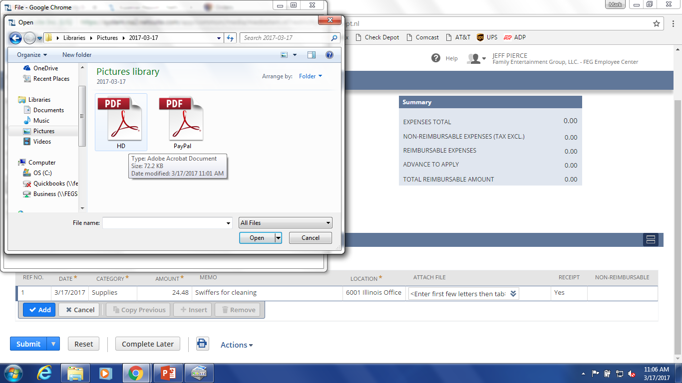
1. Then a pop up will appear
Click “Choose File”
2. Navigate to your receipt image on your computer and double click it

Slide 10
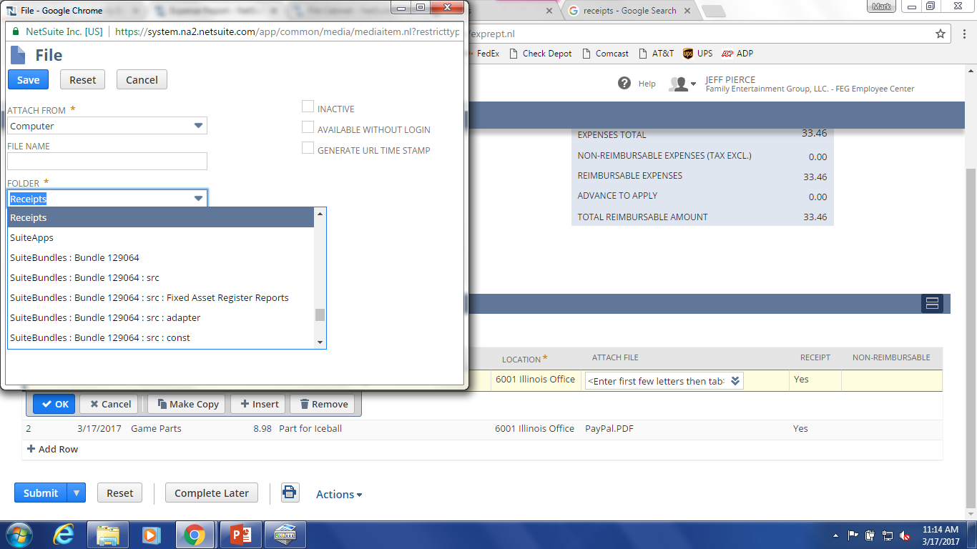
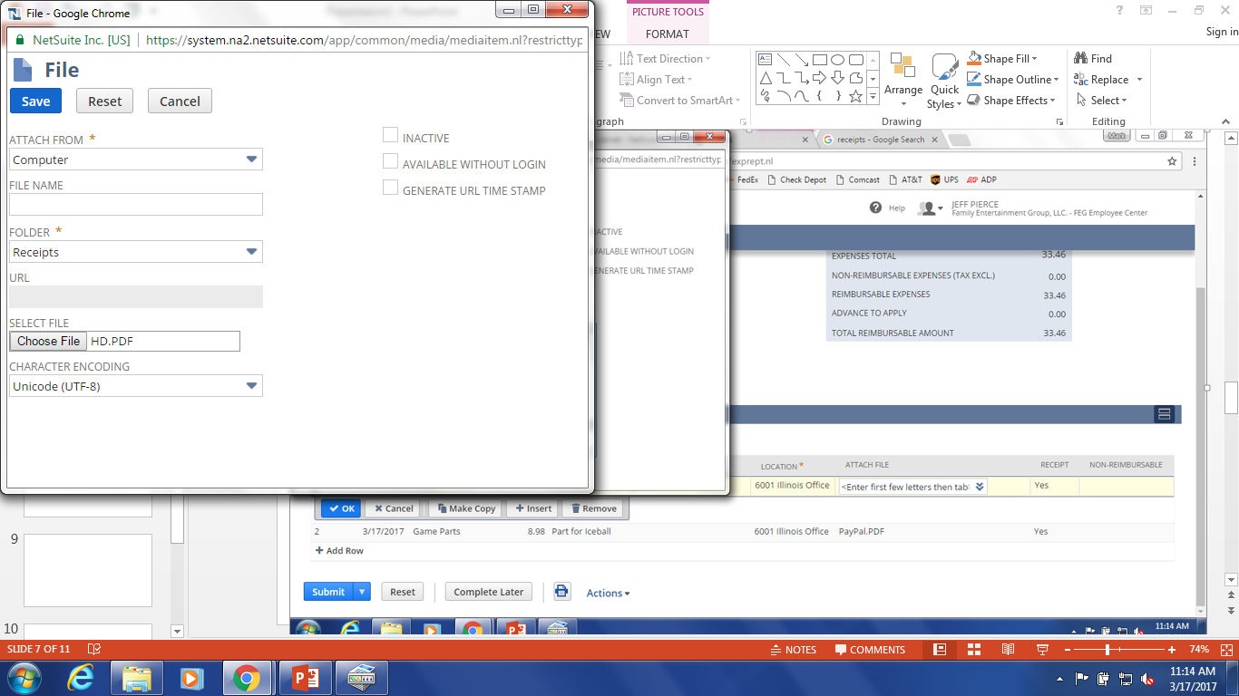
3. Type “Receipts” to change the folder.
You should only have to do this 1 time and it will remember for the next entry
4. Then click save

Slide 11
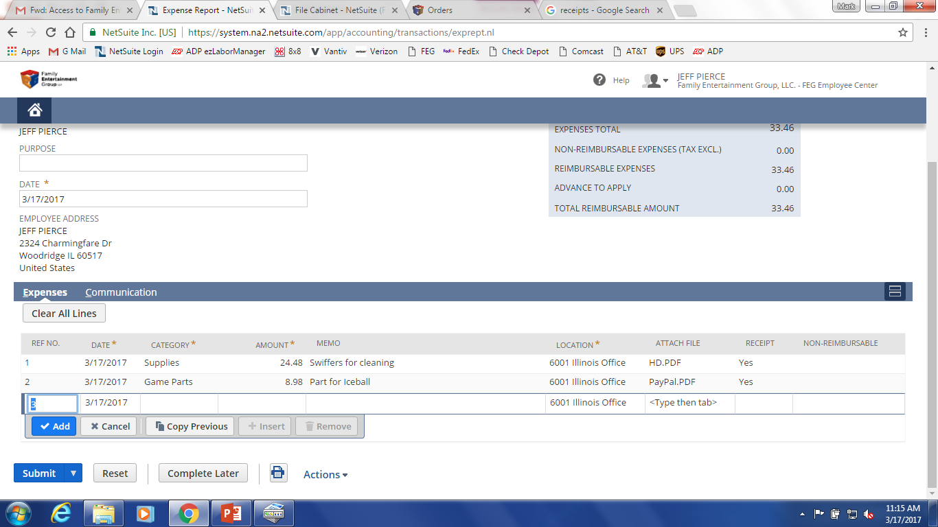
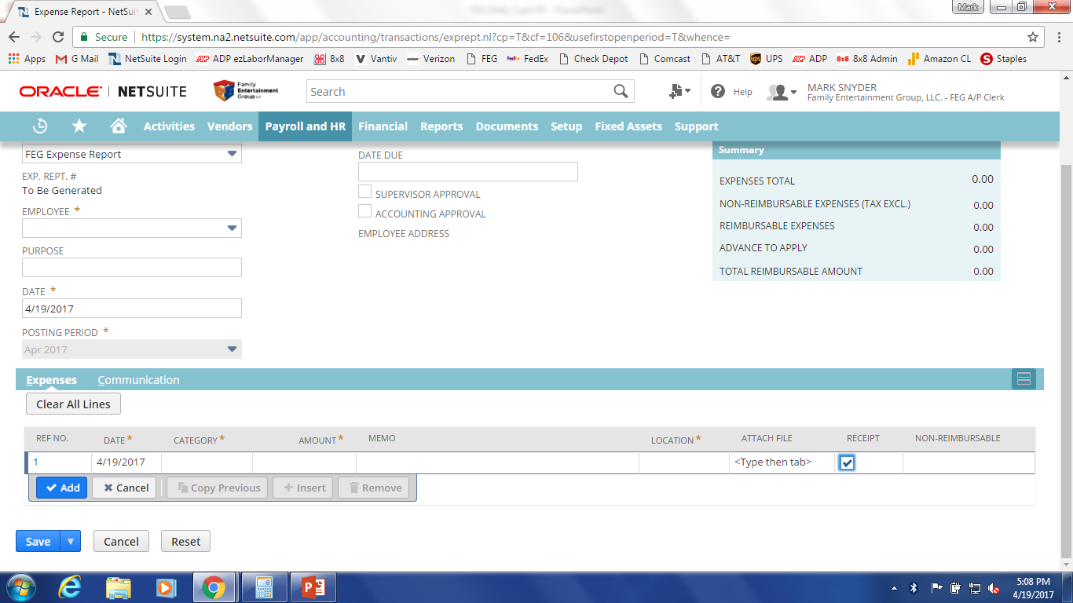
Jeff Pierce
123 Fake St.
Itasca, IL 60143
Now that you attached a receipt click the box in the receipt field so that a check mark appears

Slide 12
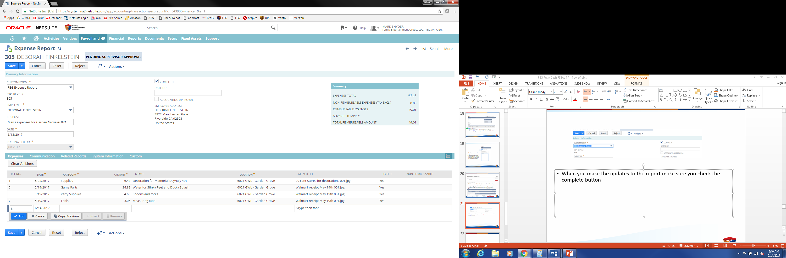
Receipts with different types of expenses
When you have a receipt that needs to be broken down into different categories please attach the receipt to each line and break down the categories shown in the example above. In this example game parts, party supplies, and tools have the same receipt attached. These lines total $42.54 and the receipt attached should reflect that.
There is no need to break down tax for each category when splitting lines. If the sales tax amount is $2 you can add it to any of the lines that have been split.

Slide 13
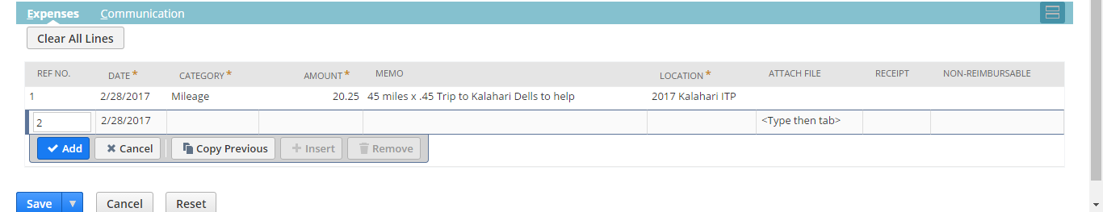
Mileage is reimbursed at .45 cents per mile. FEG will reimburse for mileage that is incurred on a personal vehicle while conducting business for FEG. Mileage to and from work is not considered reimbursable.

Slide 14
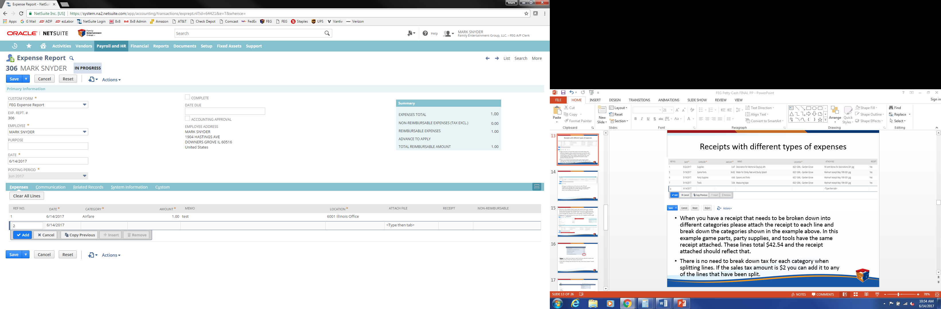
If you are in the middle of your report and need to leave your computer but do not want to lose your hard work you can save it. Make sure you uncheck the “complete” box and hit “save”. You can navigate back to the report through the employee center and clicking “View & Edit Reports.”
Please see the approval/rejection process for the navigation walkthrough.
Deb Finkelstein
123 Fake St.
Itasca, IL 60143

Slide 15
Before you submit your expense report total your physical receipts and make sure they match the expense report total.
If you have mileage that should be the only reason why it doesn’t match exactly.

Slide 16
Jeff Pierce
123 Fake St.
Itasca, IL 60143
When you are finished hit submit. Once submitted you will not be able to edit the report unless your manager rejects it.

Slide 17
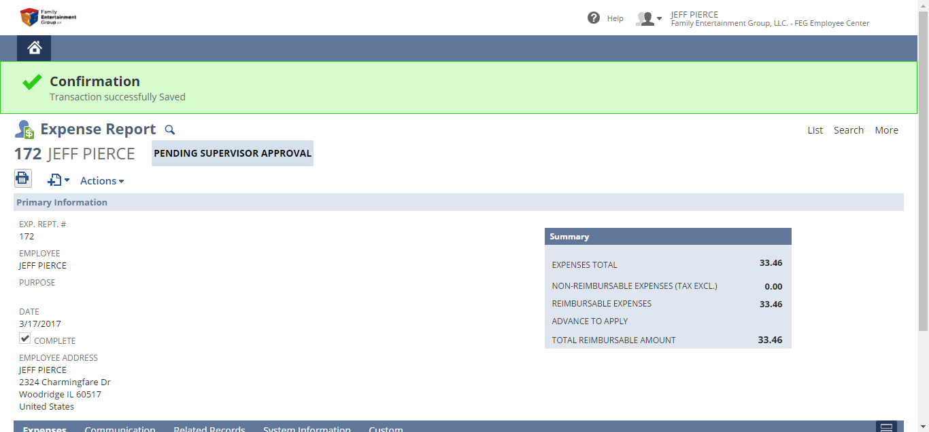
If submitted correctly it will say confirmation and a green bar will appear at the top of your screen.
Print the expense report you entered and staple the receipts to it.
Every location should keep the originals for 12 months then dispose.

Slide 18

Approval/Rejecting Reports Process

Slide 19
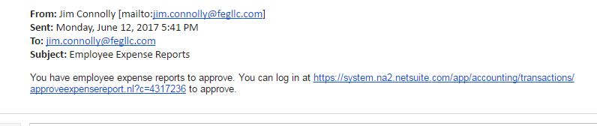
Approvals
Supervisors will receive an email letting them know they have an expense report to view.
Either click the link or navigate to the employee center using the FEG website to view it.

Slide 20
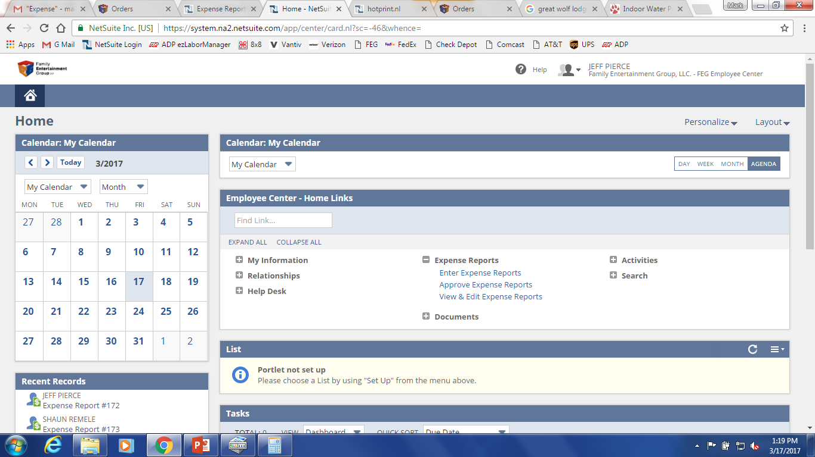
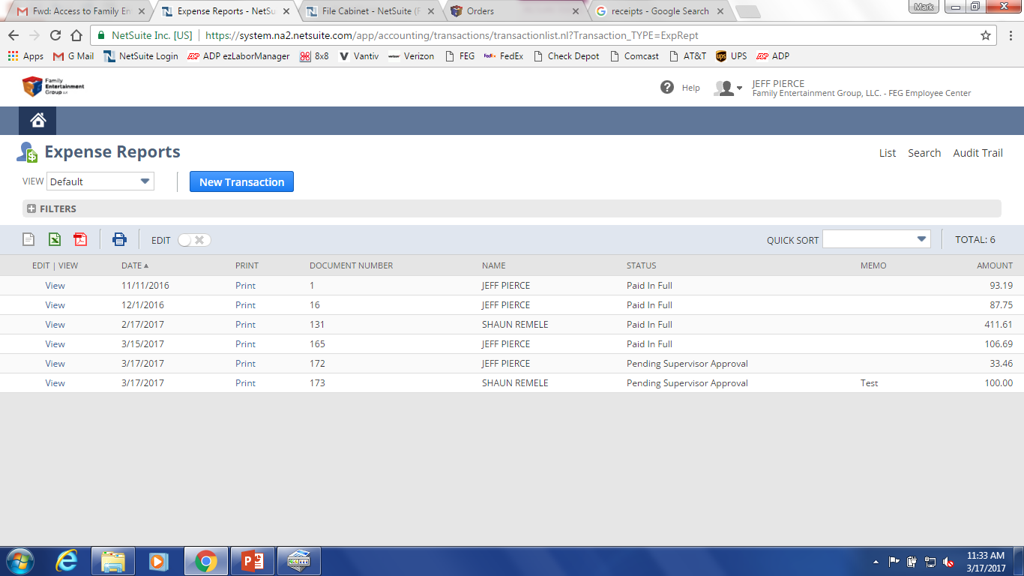
Click “Approve Expense Report”
View the expense report pending supervisor approval for the employee you wish to approve

Slide 21

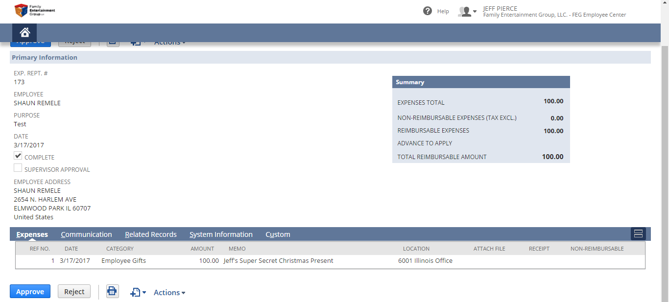
Rejection
Shaun Remele
123 Fake St.
Itasca, IL 60143
Now you can review the report and approve or reject it.
This example has no receipt attached and is not a reimbursable expense so it will be rejected.

Slide 22
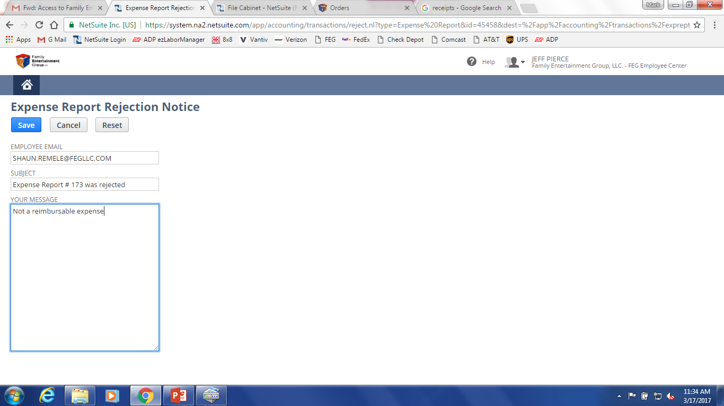
Provide a reason why it was rejected and hit save
The employee will get an email notification and they can revise the same report or delete it all together

Slide 23
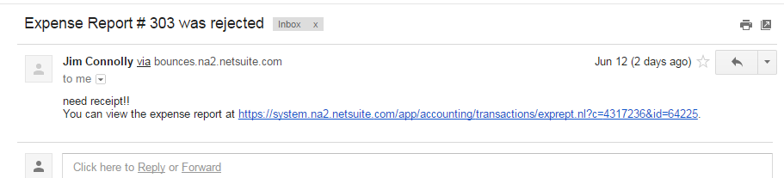
This is an example of what the rejection email looks like to the person who submitted the expense report. You can click the link to go to the report or navigate to the FEG website portal. When in the employee center click “View & Edit Reports.”

Slide 24
When you make the updates to the report make sure you check the “complete” button and click “save” in the lower left corner. If you do not check the complete box your supervisor will not get an email notification that it is ready to be approved.
Also make sure to print the updated report and throw out the old report the that you filed.
Deb Finkelstein
123 Fake St.
Itasca, IL 60143

Slide 25
FAQ
Navigate back to the dashboard by clicking the home button in the upper left
Jeff Pierce
123 Fake St.
Itasca, IL 60143

Slide 26
FAQ
If accounting finds an error they will adjust the according fields and will not reject the report if it is a small error
If your address is incorrect you can edit the profile information
Your location will prefill in the transaction category but if a different location is benefiting from the expense please change the location. If your default location is wrong please email ap@fegllc.com
For supervisors, if you are getting approval notifications for an employee not in your territory please email ap@fegllc.com for it to be corrected.

